Slide 1
Theory of Cost
Dr. Anwesha Aditya
IIT Kharagpur
References
Pindyck & Rubinfeld
Silberberg & Suen (The structure of Economics: A Mathematical Analysis)
Henderson & Quandt

Slide 2
Economic Cost versus Accounting Cost
Accounting cost Actual expenses plus depreciation charges for capital equipment.
Economic cost Cost to a firm of utilizing economic resources in production, including opportunity cost.
Explicit cost Cost associated with factor payment
Implicit cost Missed out costs/ opportunity cost- the return that a factor could have earned from the next best alternative
Opportunity cost Cost associated with opportunities that are forgone when a firm’s resources are not put to their best alternative use.

Slide 3
Sunk cost
Sunk cost Expenditure that has been made and cannot be recovered.
Main features:
Irrecoverable after stopping production; it should not influence the firm’s decisions.
It has zero opportunity cost because it has no alternative use;
Independent of level of output;
Contractual payments are sunk during the period contract
Example: Consider the purchase of specialized equipment for a plant. Suppose the equipment can be used to do only what it was originally designed for and cannot be converted for alternative use. The expenditure on this equipment is a sunk cost. Thus it should not be included as part of the firm’s economic costs.

Slide 4
Fixed Costs and Variable Costs
● Total cost (TC or C) Total economic cost of production, consisting of fixed and variable costs.
● Fixed cost (FC) Cost that does not vary with the level of output and that can be eliminated only by shutting down.
Features:
Doesn’t depend on level of output;
Not a sunk cost as it is recoverable after stopping production;
Exists only in short run;
Cost incurred on fixed factors
Over a very short time horizon—say, a few months—most costs are fixed. Over such a short period, a firm is usually obligated to pay for contracted shipments of materials.

Slide 5
● Variable cost (VC) Cost that varies as output varies.
Features:
Costs associated with variable factors;
In short run labour cost is the only variable cost;
In long run all costs are variable.
Over a very long time horizon—say, ten years—nearly all costs are variable. Workers and managers can be laid off (or employment can be reduced by attrition), and much of the machinery can be sold off or replaced as it becomes obsolete and is scrapped.

Slide 6
Average Cost
● average total cost (ATC) Firm’s total cost divided by its level of output.
● average fixed cost (AFC) Fixed cost divided by the level of output.
● average variable cost (AVC) Variable cost divided by the level of output.

Slide 7

Marginal Cost (MC)
●Increase in cost resulting from the production of one extra unit of output.
Because fixed cost does not change as the firm’s level of output changes, marginal cost is equal to the increase in variable cost or the increase in total cost that results from an extra unit of output.
We can therefore write marginal cost as

Slide 8
Short run cost function
Let the input vector be:
Cost equation:
C = w₁x₁ + w_{i}x_{i} = w₁x₁(Q, x₂) + F
Choice of variable factor doesn’t depend on wage in short run but it depends in long run.
STC= C(Q, y, w) + F

Slide 9


The Determinants of Short-Run Cost
The change in variable cost is the per-unit cost of the extra labor w times the amount of extra labor needed to produce the extra output ΔL. Because ΔVC = wΔL, it follows that
The extra labor needed to obtain an extra unit of output is ΔL/Δq = 1/MP_{L}. As a result,
(1)
Diminishing Marginal Returns and Marginal Cost
Diminishing marginal returns means that the marginal product of labor declines as the quantity of labor employed increases.
As a result, when there are diminishing marginal returns, marginal cost will increase as output increases.

Slide 10
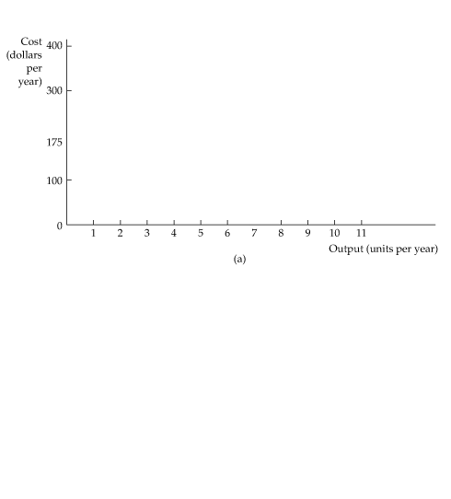



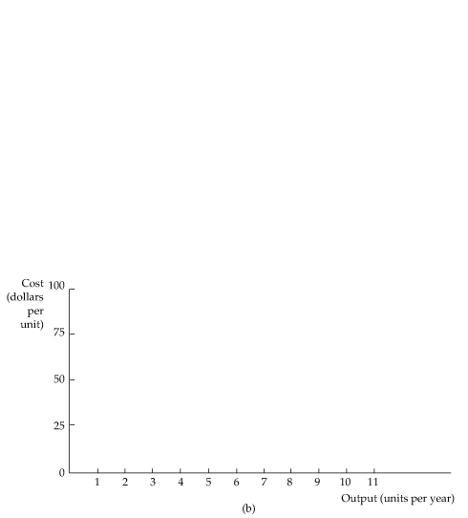

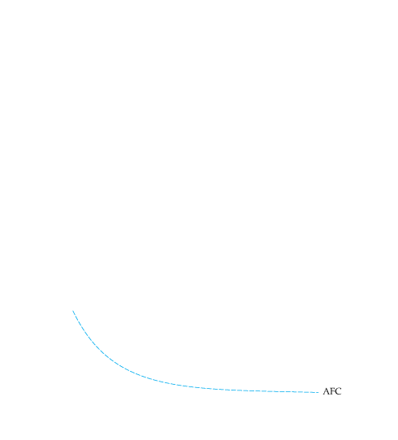
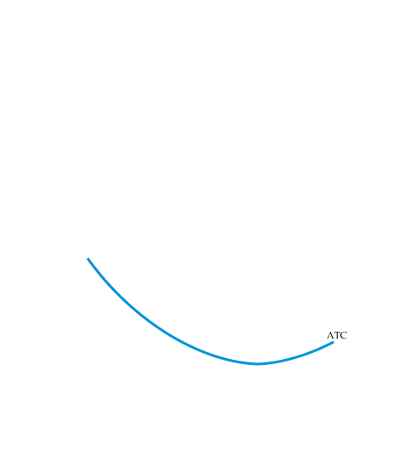
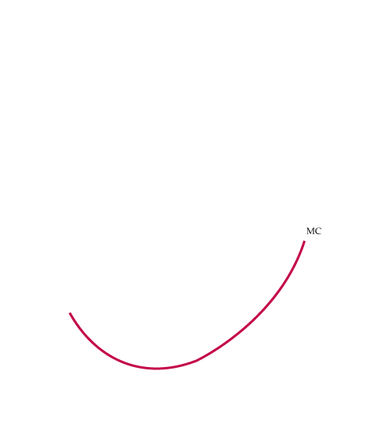
The Shapes of the Cost Curves
Cost Curves for a Firm
In (a) total cost TC is the vertical sum of fixed cost FC and variable cost VC.
In (b) average total cost ATC is the sum of average variable cost AVC and average fixed cost AFC.
Marginal cost MC crosses the average variable cost and average total cost curves at their minimum points.

Slide 11
Properties
1. Q=0 => STC=F

Slide 12
Relationship among SAVC, SATC, SMC Mathematically
SATC= SAVC + AFC = C/Q + F/Q
When
When
SAVC = w₁x₁ (Q, y)/ Q = w₁/AP₁
Similarly, SMC = w₁/MP₁

Slide 13
Q = TP
X
MP AP
MP
SMC is mirror image of MP.
SAVC is mirror image of AP.
AP
L*
X

Slide 14

Example of a firm’s cost
Rate of Fixed Variable Total Marginal Average Average Average
Output Cost Cost Cost Cost Fixed Cost Variable Cost Total Cost
(Units (Dollars (Dollars (Dollars (Dollars (Dollars (Dollars (Dollars
per Year) per Year) per Year) per Year) per Unit) per Unit) per Unit) per Unit)
(FC) (VC) (TC) (MC) (AFC) (AVC) (ATC)
(1) (2) (3) (4) (5) (6) (7)
0 50 0 50 -- -- -- --
1 50 50 100 50 50 50 100
2 50 78 128 28 25 39 64
3 50 98 148 20 16.7 32.7 49.3
4 50 112 162 14 12.5 28 40.5
5 50 130 180 18 10 26 36
6 50 150 200 20 8.3 25 33.3
7 50 175 225 25 7.1 25 32.1
8 50 204 254 29 6.3 25.5 31.8
9 50 242 292 38 5.6 26.9 32.4
10 50 300 350 58 5 30 35
11 50 385 435 85 4.5 35 39.5

Slide 15
Derivation of SR cost function from a production function: Example of Cobb-Douglas production function:
C= wL + rK = wL+F

Slide 16
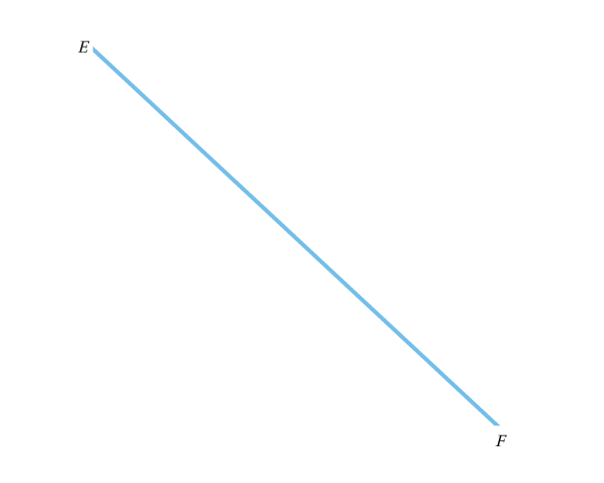
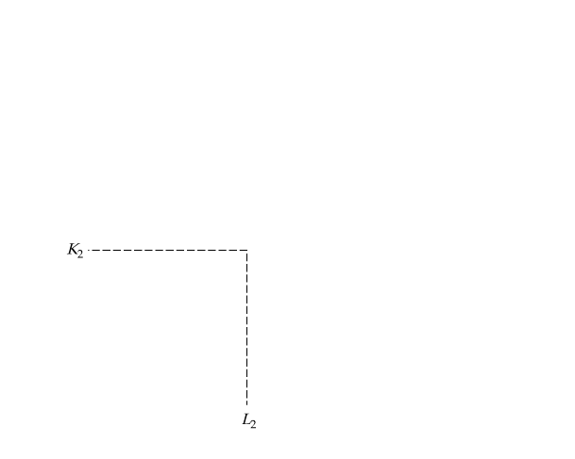
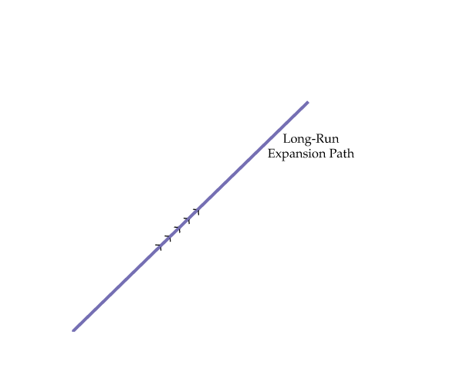
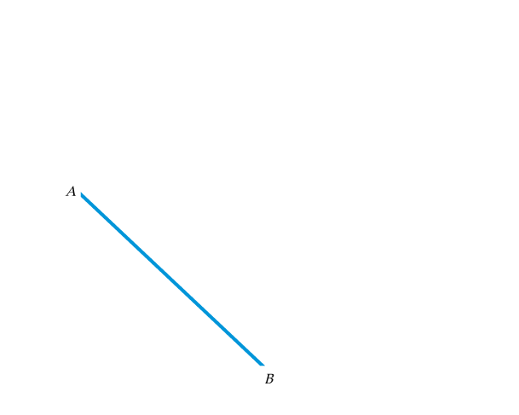
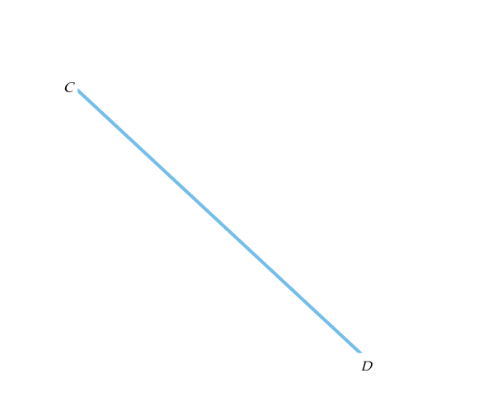
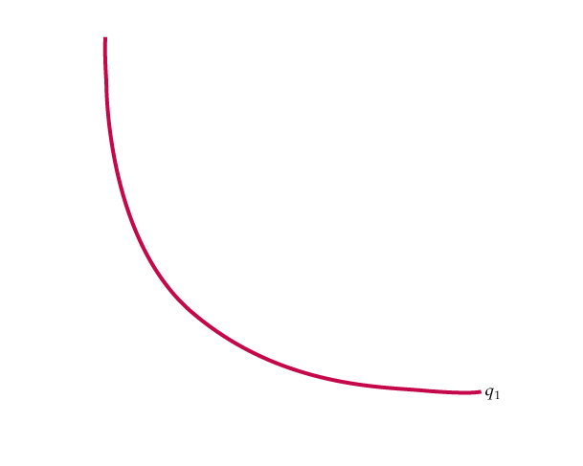
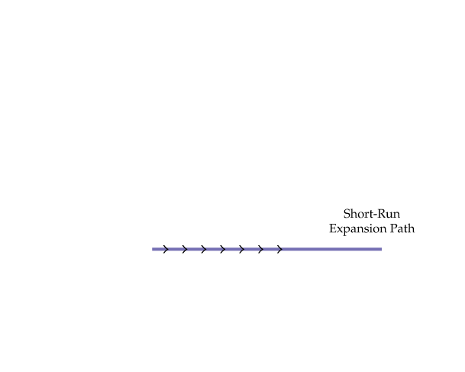
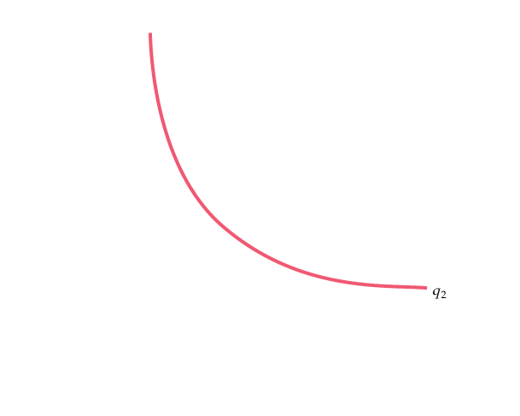
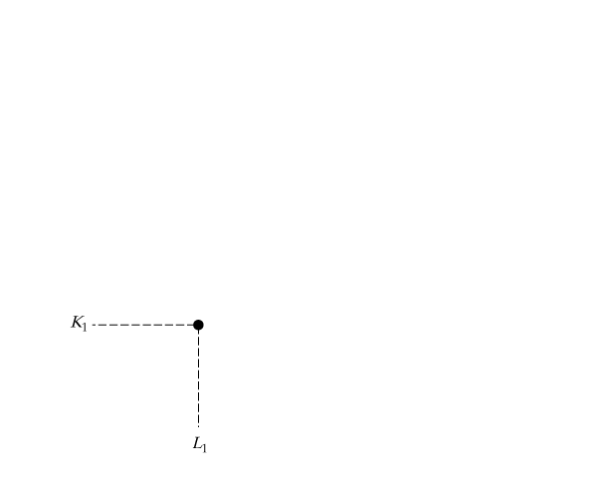
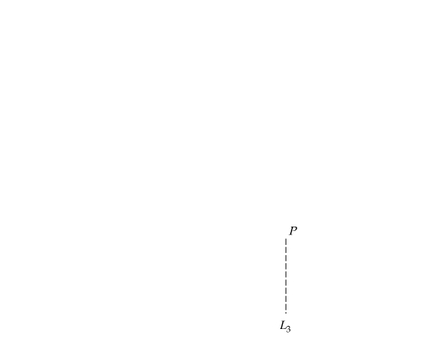
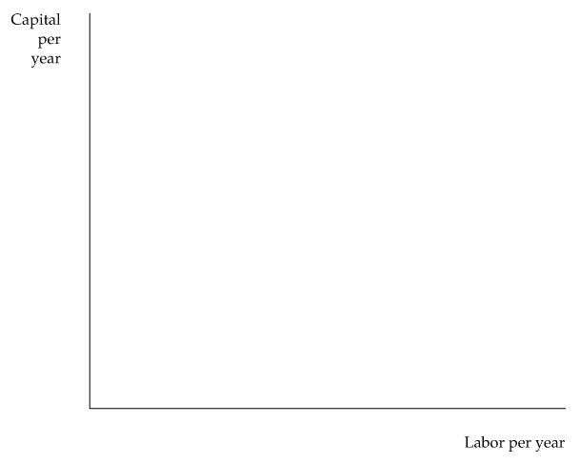
Note that short run cost is not necessarily the minimum cost.
The Inflexibility of Short-Run Production
When a firm operates in the short run, its cost of production may not be minimized because of inflexibility in the use of capital inputs.
Output is initially at level q₁.
In the short run, output q₂ can be produced only by increasing labor from L₁ to L₃ because capital is fixed at K₁.
In the long run, the same output can be produced more cheaply by increasing labor from L₁ to L₂ and capital from K₁ to K₂.

Slide 17
LONG-RUN VERSUS SHORT-RUN COST CURVES
● long-run average cost curve (LAC) Curve relating average cost of production to output when all inputs, including capital, are variable.
● short-run average cost curve (SAC) Curve relating average cost of production to output when level of capital is fixed.
● long-run marginal cost curve (LMC) Curve showing the change in long-run total cost as output is increased incrementally by 1 unit.

Slide 18
Plant size and family of SAVCs
C
SATC(F1)
SATC(F2)
SATC(F3)
Q0
Q1
Q2
Q

Slide 19
LR versus SR Cost
Long run: planning period
Short run: operating period
Long run cost function is governed by the law of returns to scale.
Short run function is governed by the law of variable proportion.

Slide 20
Shape of LAC
Economies and diseconomies of scale
Law of Returns to scale

Slide 21
Cost elasticity
Economies of scale (LAC>LMC)
Diseconomies of scale (LAC>LMC)

Slide 22
Function coefficient
where
IRS
CRS
DRS

Slide 23
Economies and Diseconomies of Scale
As output increases, the firm’s average cost of producing that output is likely to decline, at least to a point.
Probable reasons:
If the firm operates on a larger scale, workers can specialize in the activities at which they are most productive.
Scale can provide flexibility. By varying the combination of inputs utilized to produce the firm’s output, managers can organize the production process more effectively.
The firm may be able to acquire some production inputs at lower cost because it is buying them in large quantities and can therefore negotiate better prices. The mix of inputs might change with the scale of firm’s operation if managers take advantage of lower-cost inputs.

Slide 24
At some point, however, it is likely that the average cost of production will begin to increase with output.
There are three reasons for this shift:
At least in the short run, factory space and machinery may make it more difficult for workers to do their jobs effectively.
Managing a larger firm may become more complex and inefficient as the number of tasks increases.
The advantages of buying in bulk may have disappeared once certain quantities are reached. At some point, available supplies of key inputs may be limited, pushing their costs up.

Slide 25
Properties of Long Run Cost Function:
LAC is the lower envelope of all SACs.
Each point on LMC represents SMC for the corresponding level of output.
Each point on TC &/or LAC represents minimum cost for the corresponding level of output.
If a production function first obeys IRS, then CRS, followed by DRS then the associated LAC must be U-shaped.
Cost elasticity varies along with a U-shaped LAC.
LTC, LAC and LMC are homogeneous of degree one in factor prices.

Slide 26
C
LAC
LMC
Q

Slide 27
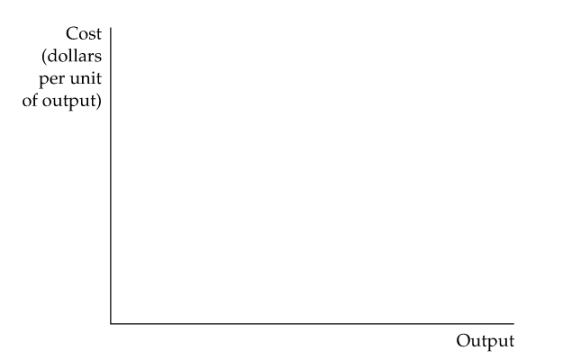

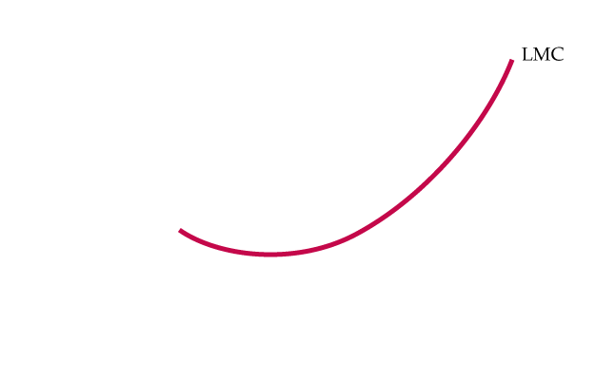
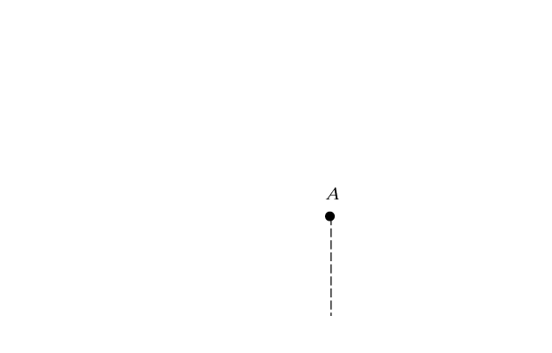
Long-Run Average and Marginal Cost
When a firm is producing at an output at which the long-run average cost LAC is falling, the long-run marginal cost LMC is less than LAC.
Conversely, when LAC is increasing, LMC is greater than LAC.
The two curves intersect at A, where the LAC curve achieves its minimum.

Slide 28
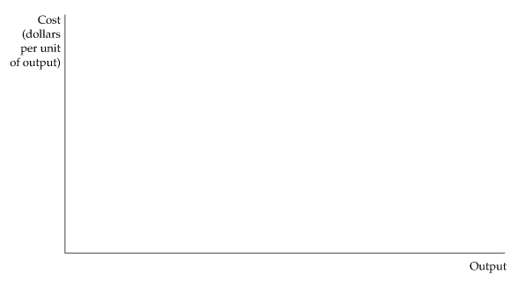
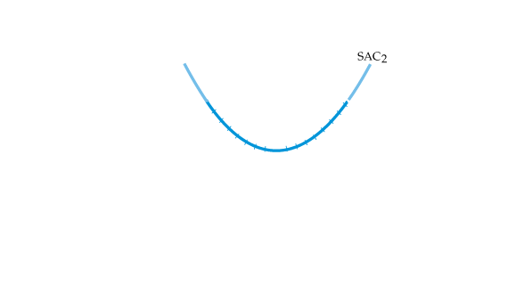
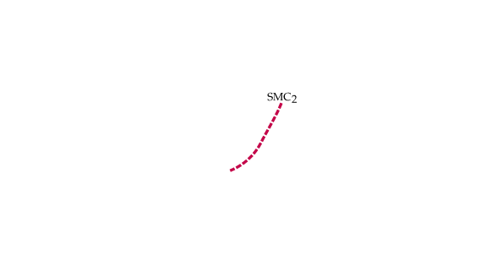
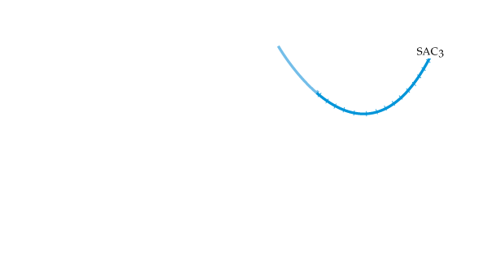
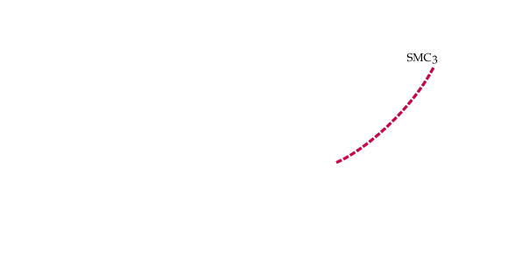
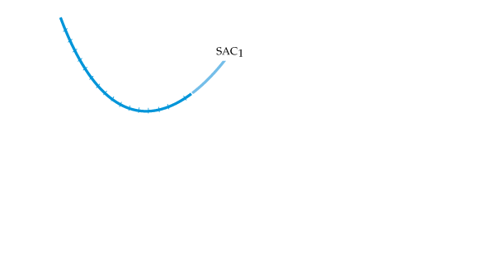
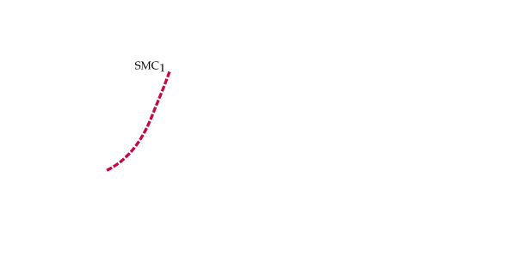
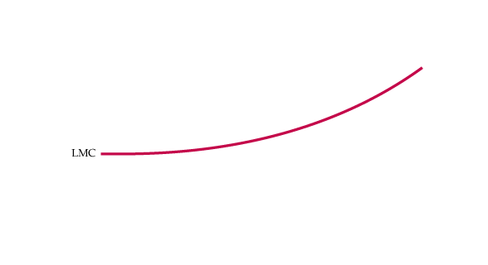
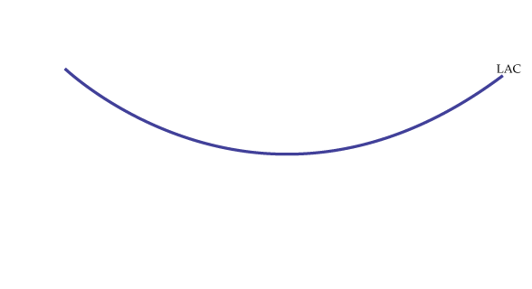
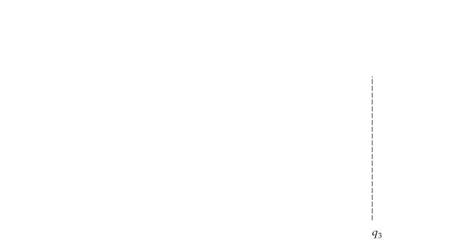


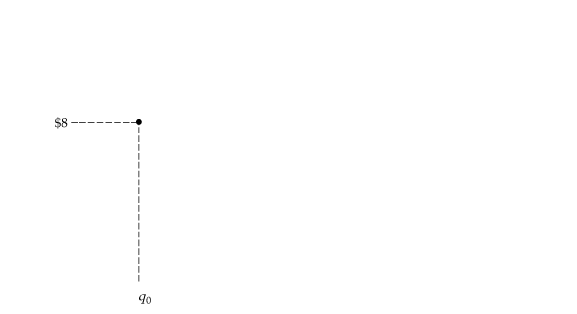
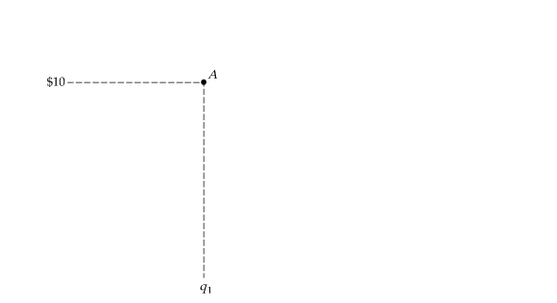
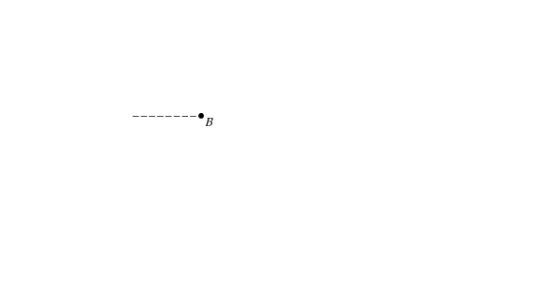
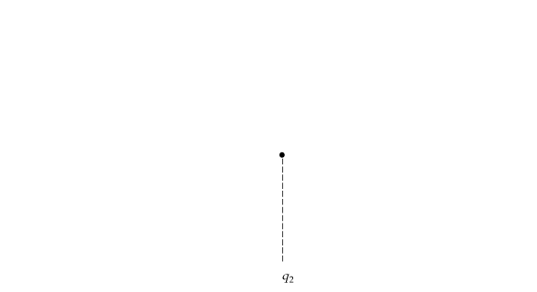
LONG-RUN VERSUS SHORT-RUN COST CURVES
The Relationship Between Short-Run and Long-Run Cost
Long-Run Cost with Economies and Diseconomies of Scale
The long-run average cost curve LAC is the envelope of the short-run average cost curves SAC₁, SAC₂, and SAC₃.
With economies and diseconomies of scale, the minimum points of the short-run average cost curves do not lie on the long-run average cost curve.

Slide 29
Remark
Jacob Viner during 1930s analyzed the relationship between SR and LR costs. He concluded that LAC is the lower envelope of all SACs. He, however, was confused. In the falling part of LAC, slope is negative. In the rising part of LAC, slope is positive. At the minimum points, slope of SAC is zero.
Samuelson solved it.
LAC is lower envelope to SAC but not at the minimum point of SAC, apart from the minimum point of LAC. Only in one special case when the production function is CRS throughout, LAC passes through the minimum point of all SACs.

Slide 30
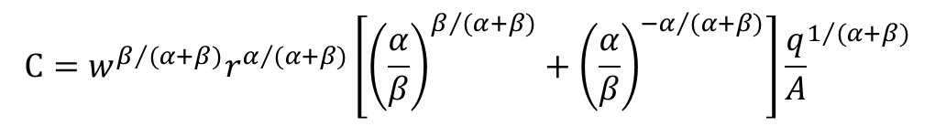
Derivation of LR cost function from a Production function:
The total cost of producing any output q can be obtained by substituting equations (24…of the preceding PPT on theory of firm) for K and (25) for L into the equation C = wL + rK. After some algebraic manipulation we find that
$$C=w^{β/{(α+β)}}r^{α/{(α+β)}}\left[{\left(\frac{α}{β}\right)}^{β/{(α+β)}}+{\left(\frac{α}{β}\right)}^{{−α}/{(α+β)}}\right]{\frac{q}{A}}^{1/{(α+β)}}$$
(26)
This cost function tells us (1) how the total cost of production increases as the
level of output q increases, and (2) how cost changes as input prices change.
For CRS equation (26) simplifies to
$$C=w^{β}r^{α}[{\left(α/β\right)}^{β}+{\left(α/β\right)}^{−α}]\left(1/A\right)q$$

Slide 31
Concepts to be read From Pindyck & Rubinfeld:
Learning: Dynamic changes in Cost; Learning curve;
Joint production;
Economies and Diseconomies of scope;
Product Transformation curve.

